Slide 1



Introduction to Economics
Tarlan Rasulov

Slide 2


What is economics?
Economic and free goods
Factors of Production

Slide 3

What is Economics?
Economics - the study of scarcity and the use of resources, production of
goods and services.
Economic problem - not being able to satisfy everyone’s wants.
Finite resources - a non-renewable and a natural resource that can finish one day. For example, fossil fuels.
More goods and services are being produced today than ever before, but the growth in wants is exceeding the growth of economic resources

Slide 4


Slide 5
Economic goods and free goods
Economic good - a product which requires resources to produce it and we pay for them.
Education, The goods we buy
Free good - a product which does not require any resources to make it and we do not pay for them.
Air, Sunlight

Slide 6
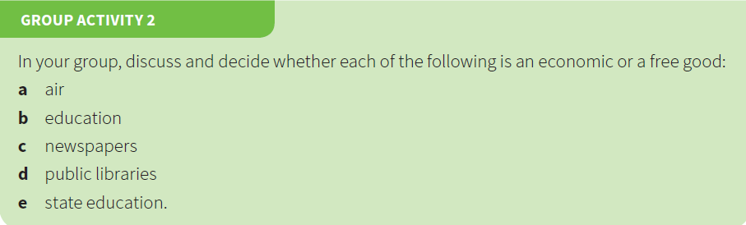

Slide 7
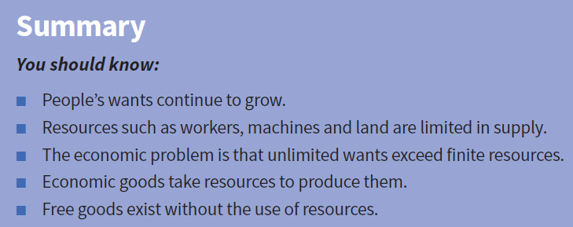

Slide 8
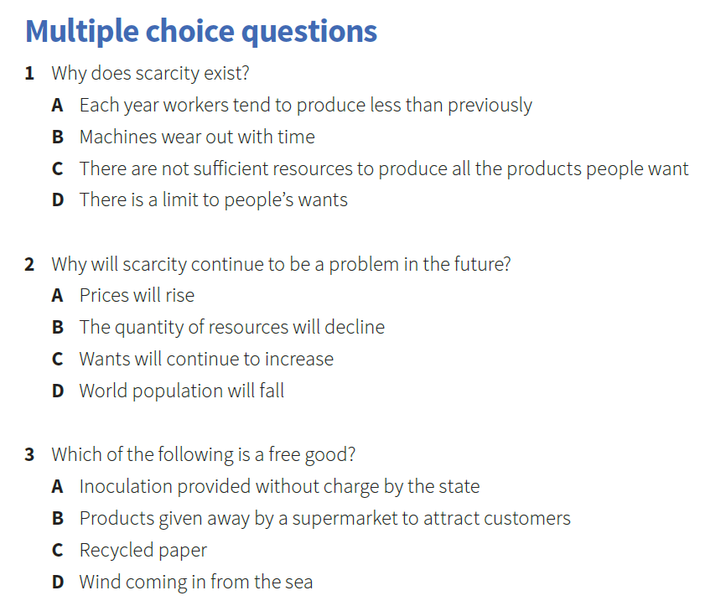

Slide 9
Homework

Slide 10
Factors of production
Factors of production - another term for economic resources
There are four factors of production:
• land
• labour
• capital
• enterprise

Slide 11
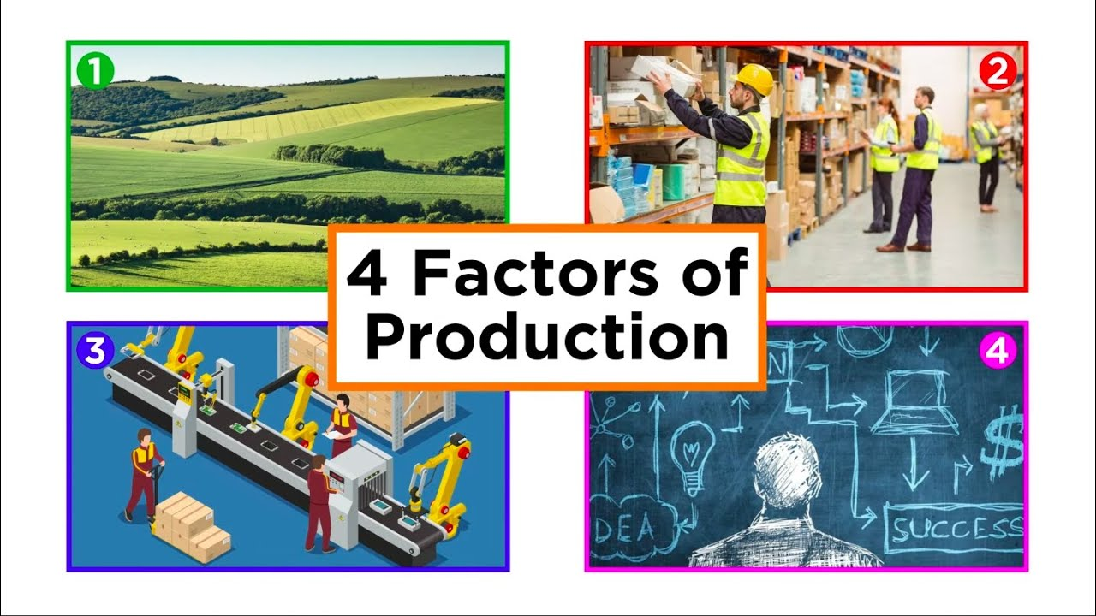

Slide 12
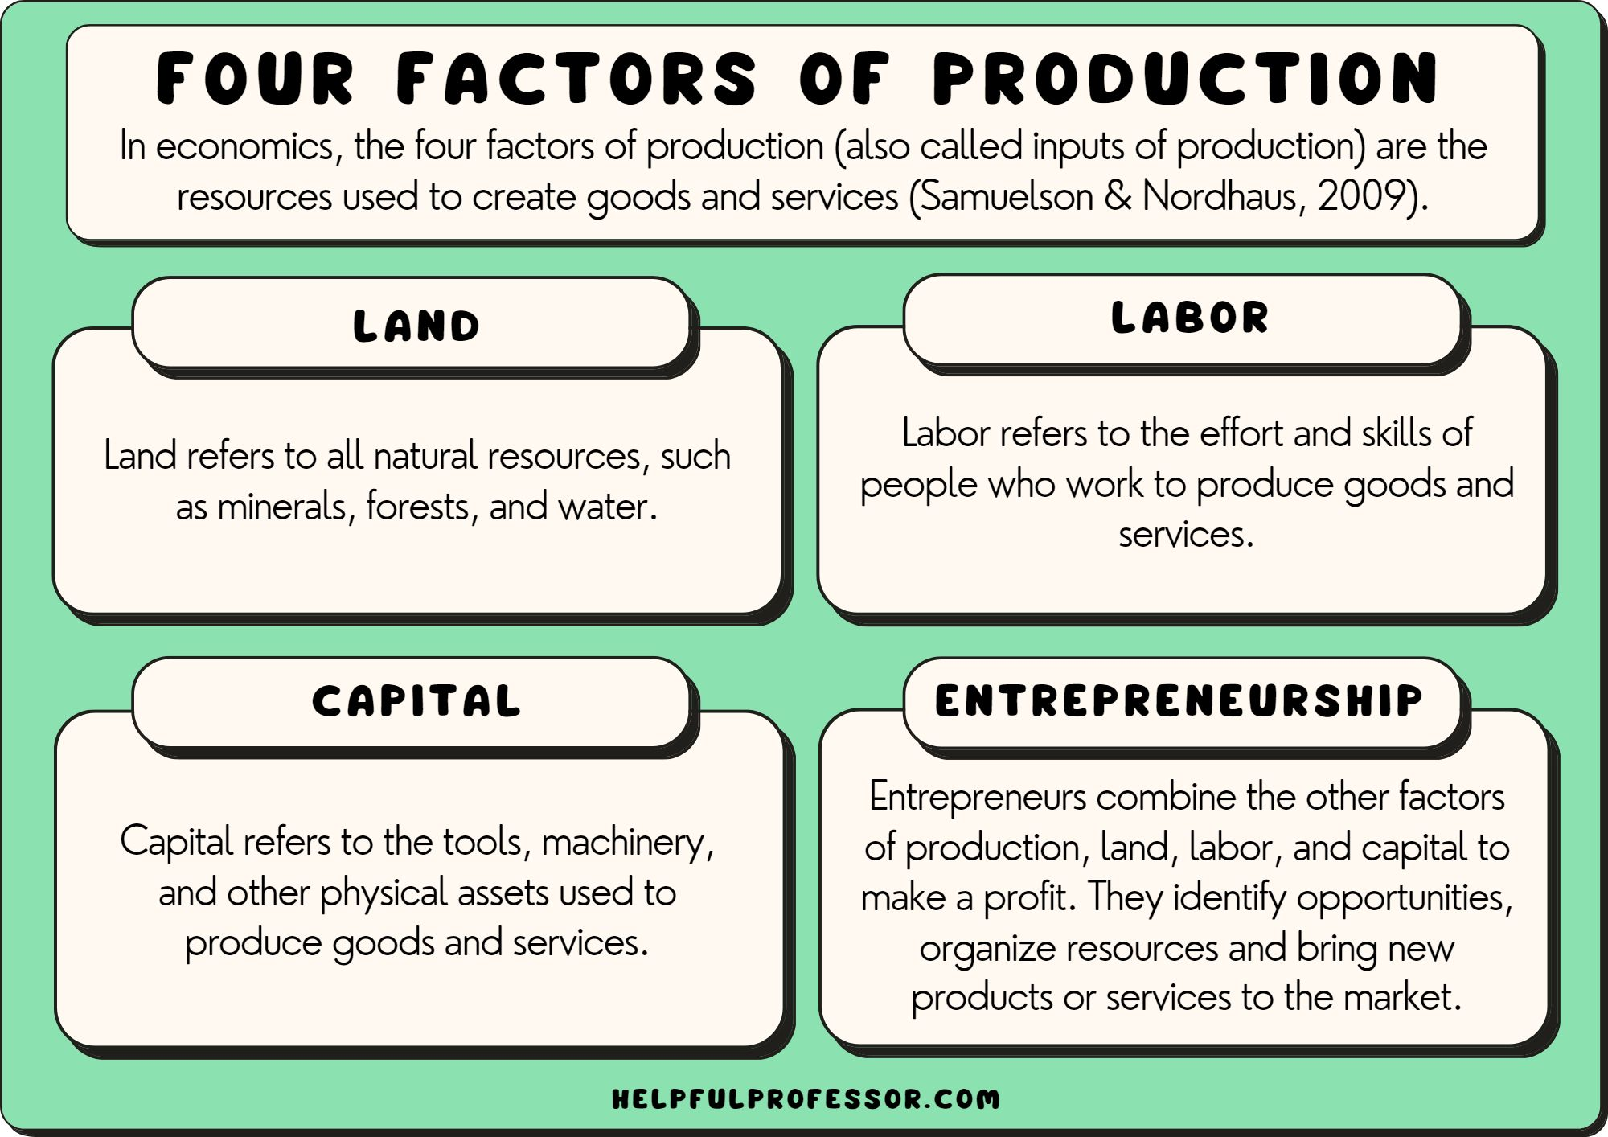

Slide 13
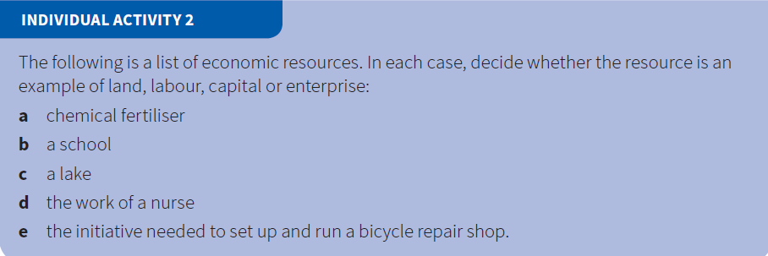

Slide 14
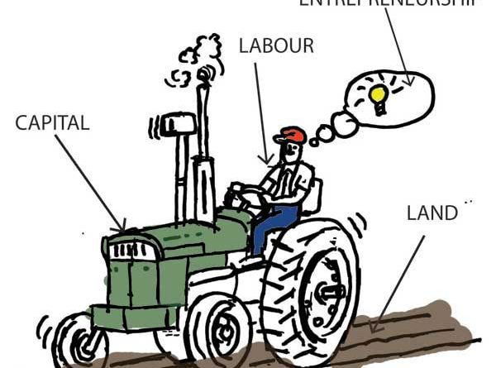

Slide 15
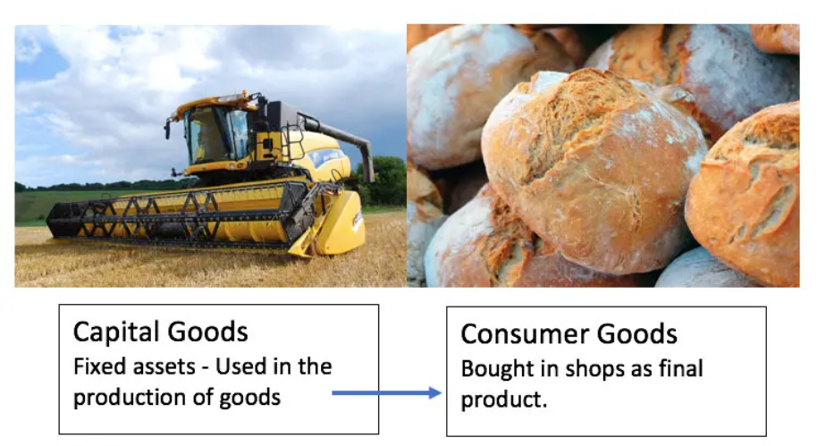

Slide 17
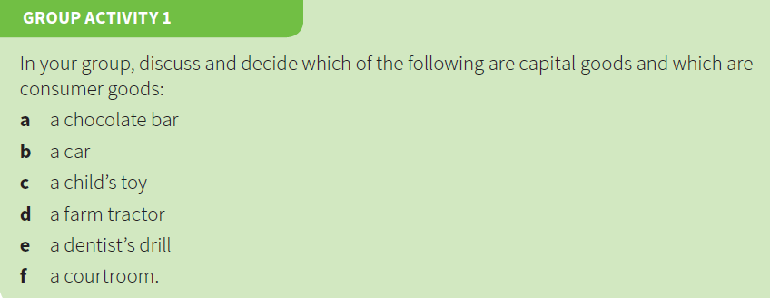

Slide 18
The mobility of factors of production
Occupationally mobile - it can be used for a number of purposes.
For example, land which is currently being used for farming may be used instead to build houses.
Geographically immobile - it is not possible to move a from one place to another.
For example, an employee rejects working in idfferent remote region fue to his personal circumstances.

Slide 19
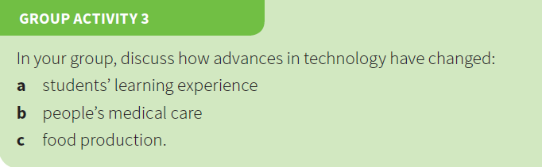

Slide 20
Net Investment
Investment: spending on capital goods.
Gross investment: total spending on capital goods.
Depreciation (capital consumption): the value of capital goods
that have worn out or become obsolete.
Net investment: gross investment minus depreciation.
Negative net investment: a reduction in the number of capital goods caused by some obsolete and worn out capital goods not being replaced.

Slide 21
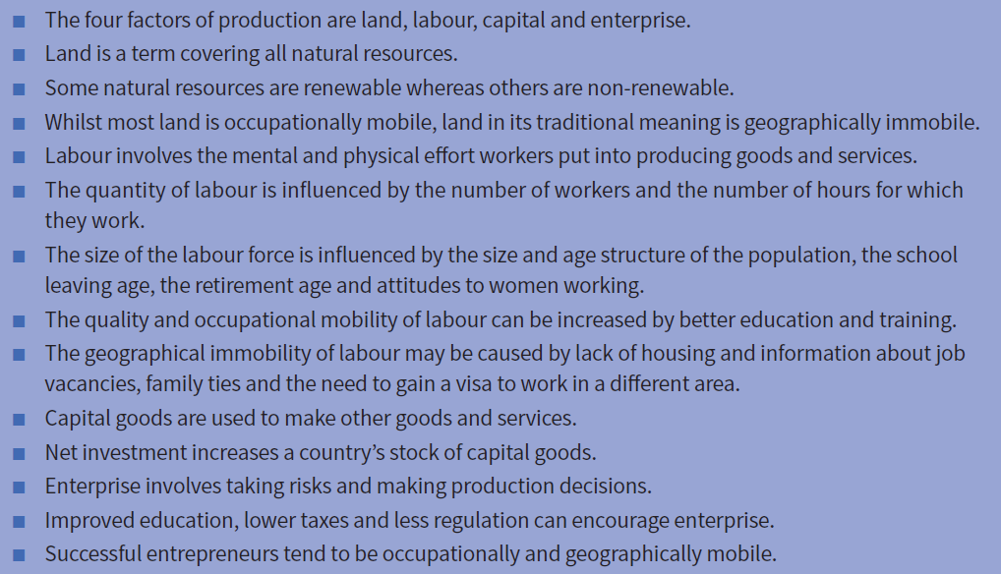

Slide 22
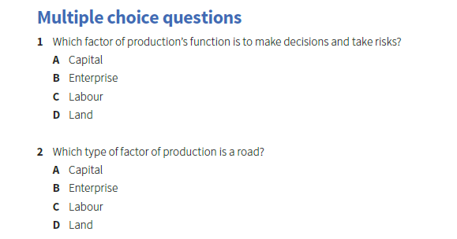

Slide 23
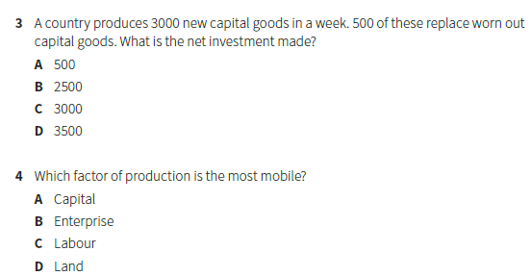

Slide 24
Homework

Slide 25
Thank You

