Slide 1



The role of markets in allocating resources
Tarlan Rasulov

Slide 2

The role of markets in allocating resources
All economies are changing and they all have to answer three fundamental economic questions:
• What to produce?
• How to produce it?
• Who is to receive the products produced?

Slide 3
The role of markets in allocating resources
Economic system - the institutions, organisations and
mechanisms that influence economic behaviour and
determine how resources are allocated.
Planned economic system - an economic system where the government makes the crucial decisions,
land and capital are state-owned and resources
are allocated by directives.
Directives - state instructions given to state-owned
enterprises.

Slide 4
The role of markets in allocating resources
Mixed economic system - an economy in which both the private and public sectors play an important role.
Market economic system - an economic system where consumers determine what is produced, resources are allocated by the price mechanism and land and capital are privately owned.
Price mechanism - the way the decisions made by households and firms interact to decide the allocation
of resources.

Slide 5
The role of markets in allocating resources
Capital-intensive - the use of a high proportion of capital
relative to labour.
Labour-intensive - the use of a high proportion of labour
relative to capital.

Slide 6
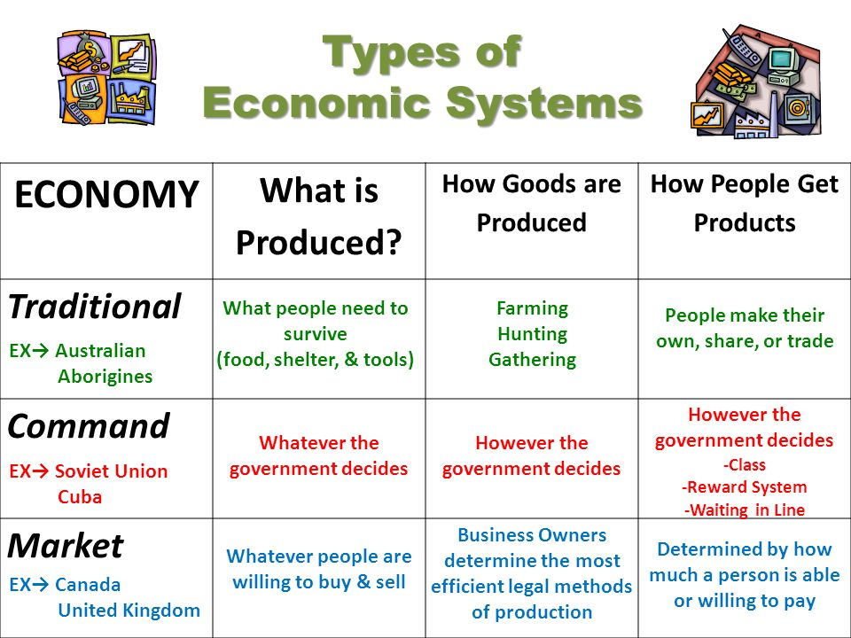

Slide 7
The role of the price mechanism
Demand - the willingness and ability to buy a product.
Supply - the willingness and ability to sell a product.
Market equilibrium - a situation where demand and supply are equal at the current price.
Market disequilibrium - a situation where demand and supply are not equal at the current price.

Slide 8
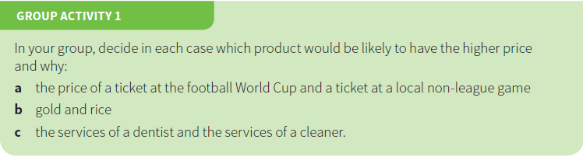

Slide 9
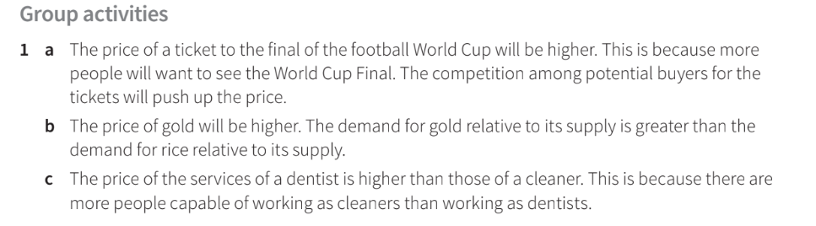

Slide 10
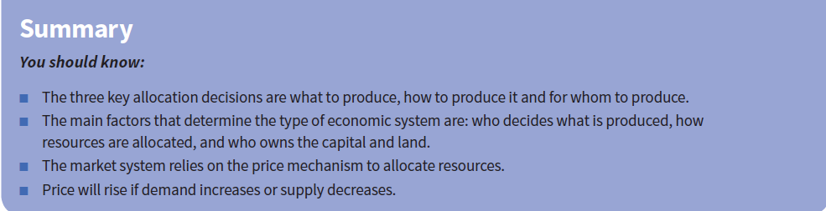

Slide 11
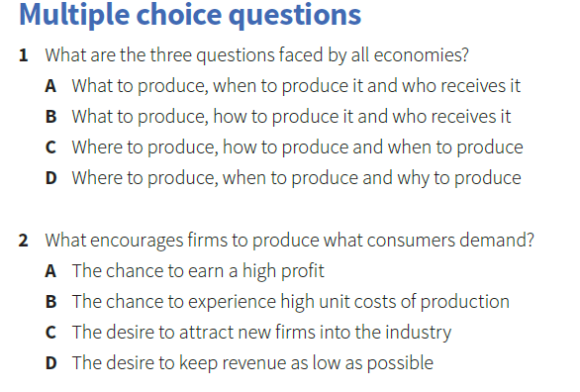

Slide 12
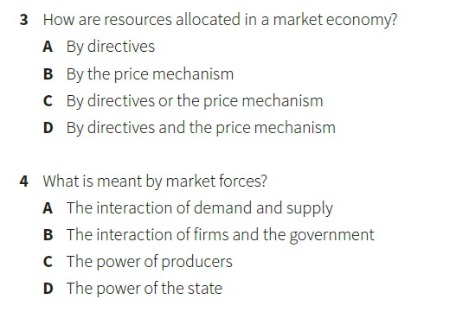

Slide 13
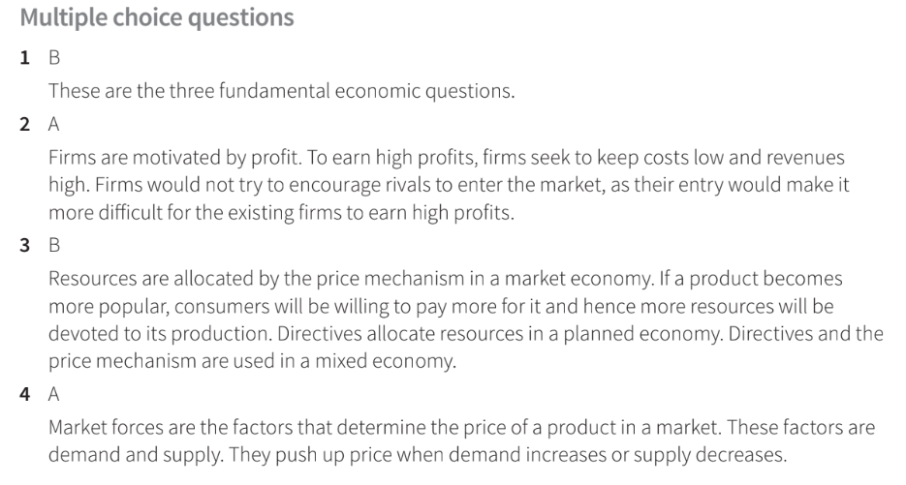

Slide 14
Thank You

